Slide 1
BBM341 Systems Programming
Kayhan İmre

Slide 2
Overview
Carnegie Mellon
Course theme
Five realities

Slide 3
Course Theme: Abstraction Is Good But Don’t Forget Reality
Carnegie Mellon
Most CS and CE courses emphasize abstraction
Abstract data types
Asymptotic analysis
These abstractions have limits
Especially in the presence of bugs
Need to understand details of underlying implementations
Useful outcomes
Become more effective programmers
Able to find and eliminate bugs efficiently
Able to understand and tune for program performance
Prepare for later “systems” classes in CS & ECE
Compilers, Operating Systems, Networks, Computer Architecture, Embedded Systems

Slide 4
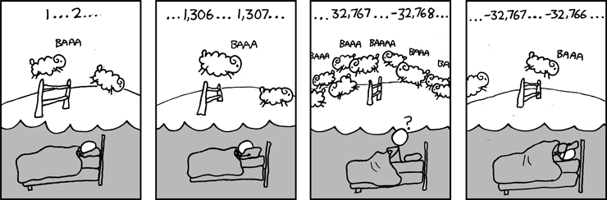
Great Reality #1: Ints are not Integers, Floats are not Reals
Carnegie Mellon
Example 1: Is x² ≥ 0?
Float’s: Yes!
Int’s:
40000 * 40000 ➙ 1600000000
50000 * 50000 ➙ ??
Example 2: Is (x + y) + z = x + (y + z)?
Unsigned & Signed Int’s: Yes!
Float’s:
(1e20 + -1e20) + 3.14 --> 3.14
1e20 + (-1e20 + 3.14) --> ??
Source: xkcd.com/571

Slide 5
Great Reality #2: You’ve Got to Know Assembly
Carnegie Mellon
Chances are, you’ll never write programs in assembly
Compilers are much better & more patient than you are
But: Understanding assembly is key to machine-level execution model
Behavior of programs in presence of bugs
High-level language models break down
Tuning program performance
Understand optimizations done / not done by the compiler
Understanding sources of program inefficiency
Implementing system software
Compiler has machine code as target
Operating systems must manage process state
Creating / fighting malware
x86 assembly is the language of choice!

Slide 6
Great Reality #3: Memory Matters Random Access Memory Is an Unphysical Abstraction
Carnegie Mellon
Memory is not unbounded
It must be allocated and managed
Many applications are memory dominated
Memory referencing bugs especially pernicious
Effects are distant in both time and space
Memory performance is not uniform
Cache and virtual memory effects can greatly affect program performance
Adapting program to characteristics of memory system can lead to major speed improvements

Slide 7
Memory Referencing Errors
Carnegie Mellon
C and C++ do not provide any memory protection
Out of bounds array references
Invalid pointer values
Abuses of malloc/free
Can lead to nasty bugs
Whether or not bug has any effect depends on system and compiler
Action at a distance
Corrupted object logically unrelated to one being accessed
Effect of bug may be first observed long after it is generated
How can I deal with this?
Program in Java, Ruby or ML
Understand what possible interactions may occur
Use or develop tools to detect referencing errors (e.g. Valgrind)

Slide 8
Memory System Performance Example
Carnegie Mellon
void copyij(int src[2048][2048],
int dst[2048][2048])
{
int i,j;
for (i = 0; i < 2048; i++)
for (j = 0; j < 2048; j++)
dst[i][j] = src[i][j];
}
void copyji(int src[2048][2048],
int dst[2048][2048])
{
int i,j;
for (j = 0; j < 2048; j++)
for (i = 0; i < 2048; i++)
dst[i][j] = src[i][j];
}
21 times slower (Pentium 4)
Hierarchical memory organization
Performance depends on access patterns
Including how step through multi-dimensional array

Slide 10
Great Reality #4: There’s more to performance than asymptotic complexity
Carnegie Mellon
Constant factors matter too!
And even exact op count does not predict performance
Easily see 10:1 performance range depending on how code written
Must optimize at multiple levels: algorithm, data representations, procedures, and loops
Must understand system to optimize performance
How programs compiled and executed
How to measure program performance and identify bottlenecks
How to improve performance without destroying code modularity and generality

Slide 11
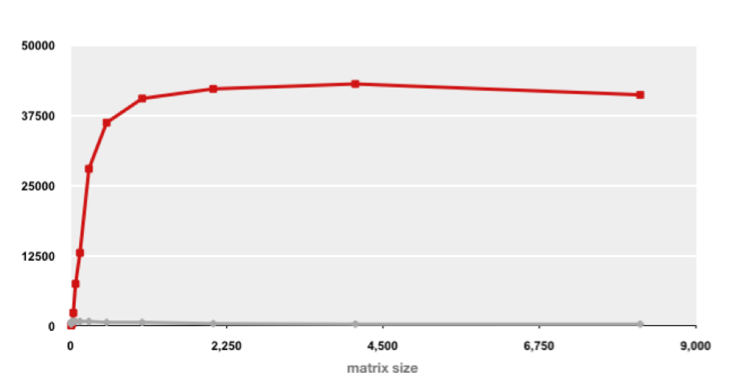
Example Matrix Multiplication
Carnegie Mellon
Matrix-Matrix Multiplication (MMM) on 2 x Core 2 Duo 3 GHz (double precision)
Gflop/s
Best code (K. Goto)
160x
Triple loop
Standard desktop computer, vendor compiler, using optimization flags
Both implementations have exactly the same operations count (2n³)
What is going on?

Slide 12
Great Reality #5: Computers do more than execute programs
Carnegie Mellon
They need to get data in and out
I/O system critical to program reliability and performance
They communicate with each other over networks
Many system-level issues arise in presence of network
Concurrent operations by autonomous processes
Coping with unreliable media
Cross platform compatibility
Complex performance issues

Slide 13
Course Perspective
Carnegie Mellon
Most Systems Courses are Builder-Centric
Computer Architecture
Design pipelined processor in Verilog
Operating Systems
Implement large portions of operating system
Compilers
Write compiler for simple language
Networking
Implement and simulate network protocols

Slide 14
Course Perspective (Cont.)
Carnegie Mellon
Our Course is Programmer-Centric
Purpose is to show how by knowing more about the underlying system, one can be more effective as a programmer
Enable you to
Write programs that are more reliable and efficient
Incorporate features that require hooks into OS
E.g., concurrency, signal handlers
Not just a course for dedicated hackers
We bring out the hidden hacker in everyone
Cover material in this course that you won’t see elsewhere

Slide 15
Textbooks
Carnegie Mellon
Randal E. Bryant and David R. O’Hallaron,
“Computer Systems: A Programmer’s Perspective, Second Edition” (CS:APP2e), Prentice Hall, 2011
http://csapp.cs.cmu.edu/2e/home.html
This book really matters for the course!
How to solve labs
Practice problems typical of exam problems
Brian Kernighan and Dennis Ritchie,
“The C Programming Language, Second Edition”, Prentice Hall, 1988

Slide 16
Programs and Data
Carnegie Mellon
Topics
Bits operations, arithmetic, assembly language programs
Representation of C control and data structures
Includes aspects of architecture and compilers

Slide 17
The Memory Hierarchy
Carnegie Mellon
Topics
Memory technology, memory hierarchy, caches, disks, locality
Includes aspects of architecture and OS

Slide 18
Performance
Carnegie Mellon
Topics
Co-optimization (control and data), measuring time on a computer
Includes aspects of architecture, compilers, and OS

Slide 19
Exceptional Control Flow
Carnegie Mellon
Topics
Hardware exceptions, processes, process control, Unix signals, nonlocal jumps
Includes aspects of compilers, OS, and architecture

Slide 20
Virtual Memory
Carnegie Mellon
Topics
Virtual memory, address translation, dynamic storage allocation
Includes aspects of architecture and OS

